Slide 1
Medical Bike Fit

Slide 2

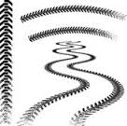
General thoughts
Evidence based approach
Feedback and communication is important
Fit the current state. Work on any deficits. Address the deficits. Recheck the fit.
Your team
  Fitter
  Medical professionals
  Coach

Slide 3
Disclosures
Everyone is different. What might work for one, may not work for another.
Sometimes it is ‘trial and error’.
Any change to the bike will affect other areas.
This talk is focusing on road bike specifically.
This talk is not comprehensive.
“May”

Slide 4
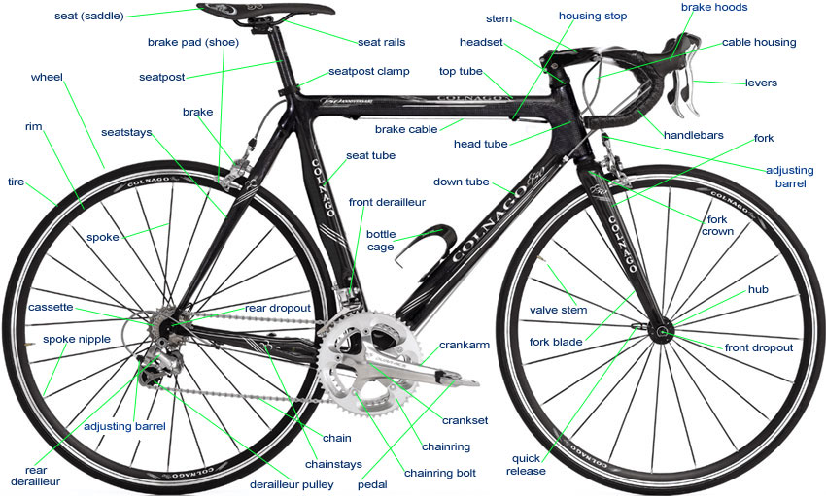

Slide 5
3 points of contact
Saddle
Pedals
Handlebars

Slide 6
PELVIS –THE CENTER OF IT ALL
If this is not right, nothing else really matters
Provides a foundation with which you are able to generate power from
Your ischial tuberosities are to contact the wider part of the saddle

Slide 7
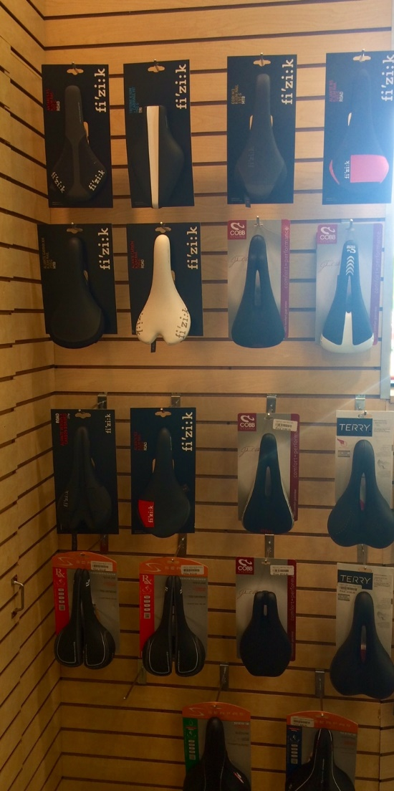
SADDLE CONSIDERATIONS
Reduce soft tissue pressure
Saddle Width
Shape
Material
Padding
Cutout or no cutout
Nose or no nose
Fore and Aft
Tilt
Seat Height

Slide 8
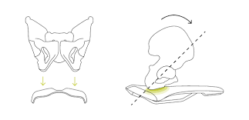
Notes:
Discuss the degrees. Not always consistent.
Talk about the measurement between the ishial tuberosities.
Where to sit on the saddle.
Women, the limited factor is usually soft tissue.
Men, the limiting factor to get in to proper position is usually hamstring length.

Slide 9
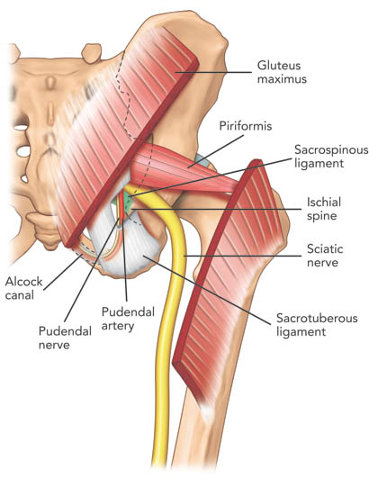
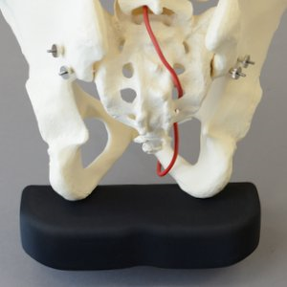

Slide 10
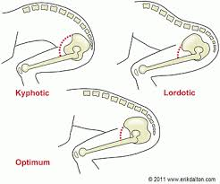

Slide 11
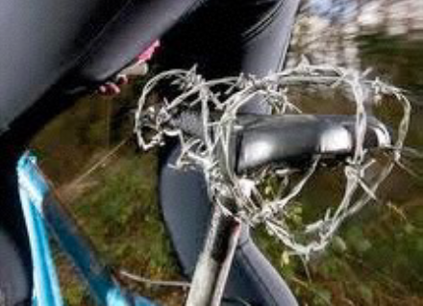
Saddle pain
Causes and Interventions
Saddle Selection
Reach
Chamois/Shorts
Position/Inability to hold position

Slide 12
SADDLE HEIGHT - TOO HIGH
Cyclist will creep forward on the saddle
Cyclist will typically point their toes (increased “ankling”)
May cause pain behind the knee
Hips may rock

Slide 13
SADDLE HEIGHT – TOO LOW
May cause anterior knee pain
Quads will tire out quickly
Cyclist may sit very further back on saddle seeking more leg extension

Slide 14
KNEE POSITION
Medial
  Pronated Foot/Toe out
  Tibial external torsion with fixed pedal
  Femoral Anteversion
Lateral
  Lack of hip flexion
  Seat low
  Hip impingement
  Femoral Retroversion

Slide 15
FOOT/SHOE/PEDAL INTERFACE
Only place that you are mechanically connected to your bike.
Not always symmetrical
Shoes need to match feet

Slide 16
FEET – THINGS TO CONSIDER
Forefoot
Rearfoot
Length of arch and foot
Width
Shape
Up the chain
  Tibial torsion
  Hip joint position
  Leg Length

Slide 18
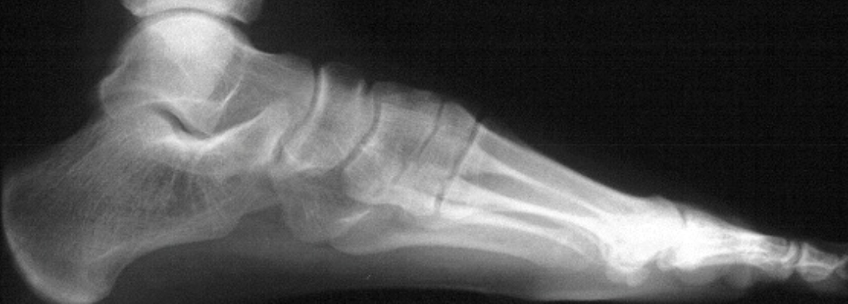
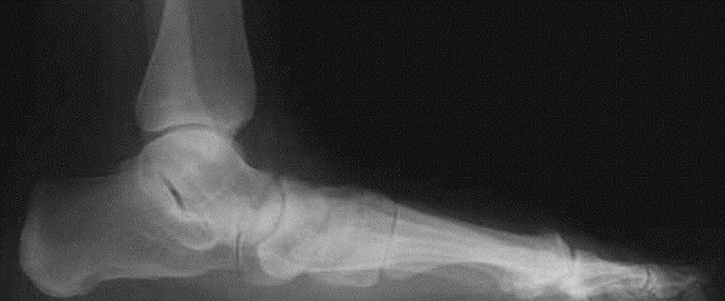

Slide 19
SHOES – COMMON PROBLEMS
Shoes not wide enough
Shoes too long, seeking width or volume
Shoes have too much volume
Brands differ/Materials differ
  Upper
  Lower/Flex
  Closure system
  Wedging
  Last

Slide 20
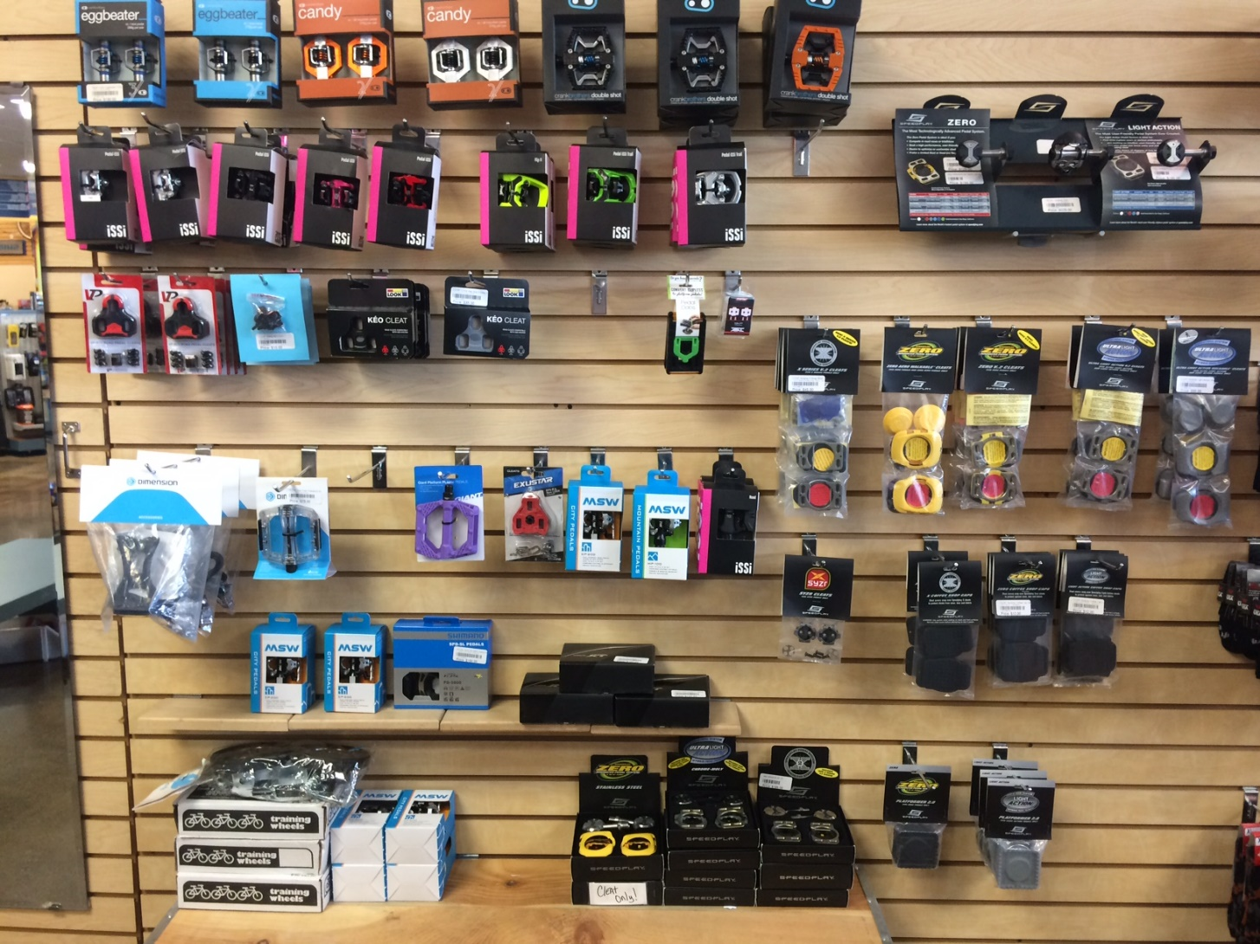
PEDAL/CLEAT SYSTEM CONSIDERATIONS

Slide 21
Foot Pain and Numbness
Causes and Interventions
Correct shoes
  Sizing
  Modifications
Cleat placement
Pedal/Cleat System choice
Posting/Orthotics
Padding
Closure type/tightness

Slide 22
Foot Pain/Numbness - Differential DX
Morton’s Neuroma
Plantar Fasciitis
Tarsal Tunnel
Compartment Syndrome
Sciatica
Lumbar Spine issues
Diabetes
Metatarsalgia
Stress fracture

Slide 23
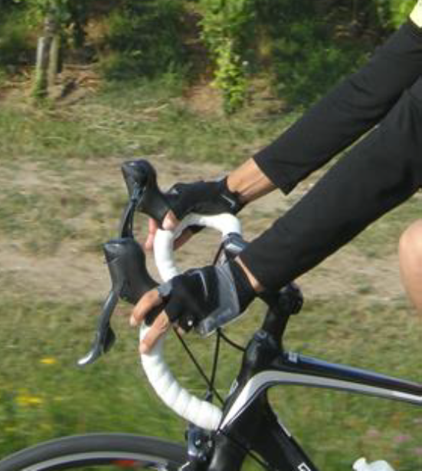
HANDLEBARS
Need to match shoulder width
Measured A/C joint to A/C joint
Handlebar reach too short
  Arms and shoulders can get jammed up and back will typically round out
Handlebar reach too long
  Shoulders can creep up toward ears
  Will typically cheat their hands back, or will slide forward on the saddle
  Extend elbow

Slide 24
Hand Numbness
Causes and Interventions
Too much weight on hands
Gloves
Hand Position
Handlebar tape
Handlebar width
Wrist neutral position recommended
Vibration

Slide 25
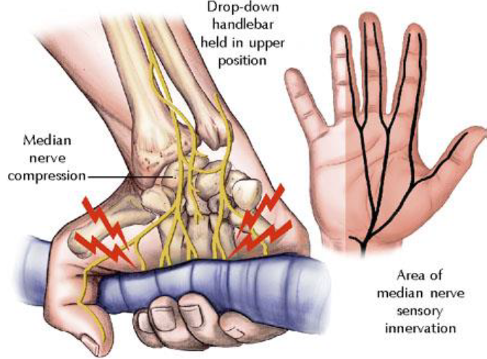
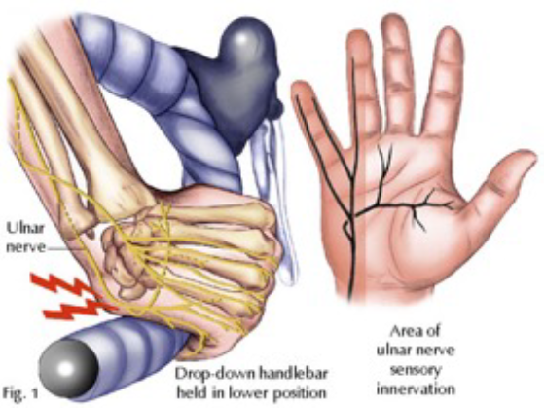

Slide 26
Hand Numbness – Differential DX
Cyclist palsy
Carpal Tunnel
Ulner Nerve Injury/Compression
Cervical spine issues
Thoracic Outlet Syndrome

Slide 27
What Now?
Foam roller
Back extension
Chest stretching
Upper back strengthening
Postural exercises
Strengthen hips and core

Slide 28
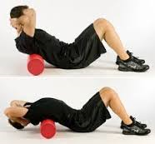
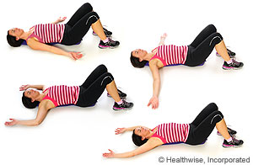
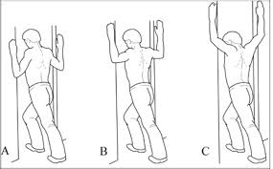

Slide 29
Thank you!
Elena Friedman, MS, ATC, CSCS, Astym cert.
Elena.Claus@athletico.com
8622 Olive Blvd.
Olivette, MO 63132

